Slide 1

The Ethics and Economics of Environmental Protection
3. Deontology and Environmental Philosophy

Slide 2
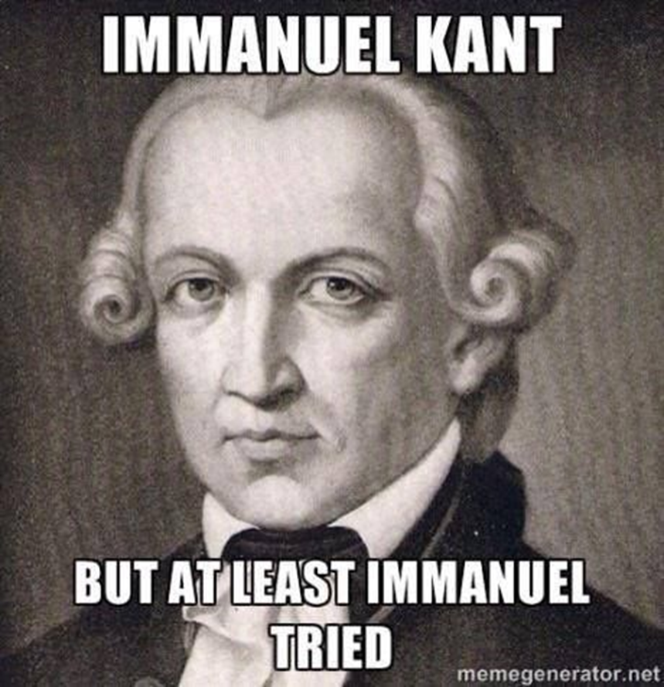
1. Reasonable decisions
Environmental decisions tend to involve questions of risk
Environmental outcomes are uncertain just to the extent that social behaviour is uncertain
Being cautious is, therefore, a risky strategy in itself
Who should have authority, then, to make environmental decisions? And what moral principles should inform these decisions?
Are they a question of duty?
Or a question of consequences?

Slide 3
An Introduction to Deontology
Deontology has its roots in the Aristotelean distinction between “logicism” and “psychologicism” (or, slightly less accurately, “logos” and “mythos”)
Logicism, or faith in reason, implies that the rules of syllogistic reasoning are universally valid, regardless of context (this compares to psychologicism, which has it that reason is always subjective)
Reason’s universality entails isomorphism between logical thought and the rational, intelligible world
The problem with logicist views is that they are disenchanting: they undermine collective myths and emphasise the limits of social life
The narrow view of reason: The world can be meaningfully understood only through rational, logically consistent reasoning
The broad view of reason: The world can and should be meaningfully understood through various, non-rational patterns of reasoning (e.g., discourse, narrative, etc.)

Slide 4

The Shadow of the Enlightenment
The European Enlightenment was a struggle to emancipate reason (logos) from myth (mythos)
The Enlightenment initiated an “age of reason” realised through critique
Critical inquiry is endemically suspicious, anti-authority, and anti-tradition; it accepts reasons only when these rest on universally valid conditions of necessity and possibility
In practice, this means the total dissolution of the conventions that hold societies together (e.g., the belief in God, or the impeccable authority of leaders)
Kant’s Critique of Pure Reason celebrates precisely this approach
“[Kant’s goal is the] self-cognition of reason, [the establishment of] a tribunal that will make reason secure in its rightful claims and will dismiss all baseless pretensions, not by fiat but in accordance with reason’s eternal and immutable laws. This tribunal is nothing other than the critique of reason itself: the critique of pure reason” (Kant 1996 [1781], 8; original emph.)

Slide 5
Kantian Ethics
Kant intended to construct a defence of the moral law against the arbitrary (i.e., unreasoned) will of despotic leaders
The Critique of Pure Reason
Seeks to rescue rational thought from Hume’s critique of “sufficient reason”: reason cannot be assumed to exist in the world
In place of the dogma of aprioristic rationalism, Kant offers a view of reason that both originates in the mind and seeks to understand the world beyond it
This view of reason is necessarily limited; it can know stable effects, but it can never know underlying reasons
The Critique of Practical Reason
Pure Reason seems to undermine the concept of freedom: how can we be free in the world if we cannot know the world?
Kant asserts that morality is rational self-legislation; it consists in the recognition of reason’s law (duty, or the deon) at the level of humanity as a whole
Practical reason thus allows no more or less than that we apply the law of reason (the categorical imperative) to our own moral beliefs
The moral imperative tells us that humans should always be treated as ends, not means, and that human freedom can be realised only within a universal “kingdom of ends”

Slide 6
2. Rights vs. Consequences
 | Common deontologies and their applications |  | Consequential concerns
1. | Kantian metaethics | Transcendentalism | Nuomenal duties can be counter-intuitive: why should I adopt rights that have vicious consequences?
2. | Contractarianism | Voluntary social contracts | The social contract is under-determined: how do we know whether the “contract” is right for us?
3. | Libertarianism | Individual property rights | Libertarian side-constraints seem to be unachievable: how can we ensure that every impact we have on one another is consented to?
4. | Liberal egalitarianism | Primary goods and the difference principle | The difference principle is potentially repugnant: should we, for instance, accept widespread harm to animals and the environment to ensure tiny gains for the poor?
5. | Intergenerational justice | Sustainability | Intergenerational justice is epistemically implausible: how can we know what we should leave those who haven’t yet been born?

Slide 7
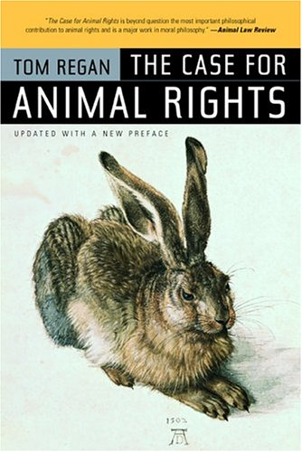
3. Rights for nature
Rights for nature (or “eco-centric” rights) entail a break with the Kantian idea that the moral law only applies to humans (who are, uniquely, capable of moral autonomy)
According to philosophers like Tom Regan and Paul Taylor, human exceptionalism is “species-ism”, which (they argue) is equivalent to racism and sexism
Applying “eco-centric” rights therefore entails challenging orthodox deontologies on several grounds
Against the claim that human reason is superior: Humans and non-humans share membership of the “community of life” on equal terms
Against the distinction between pure and practical reason: The ecosystems in which the community of life are embedded are fully inter-connected
Against the equation of morality with duty or autonomy: Every organism and ecosystem (including the meta-system) has its own unique telos
Against the speciesist “kingdom of ends”: Humans should see all living things as ends in themselves, not merely humans

Slide 8
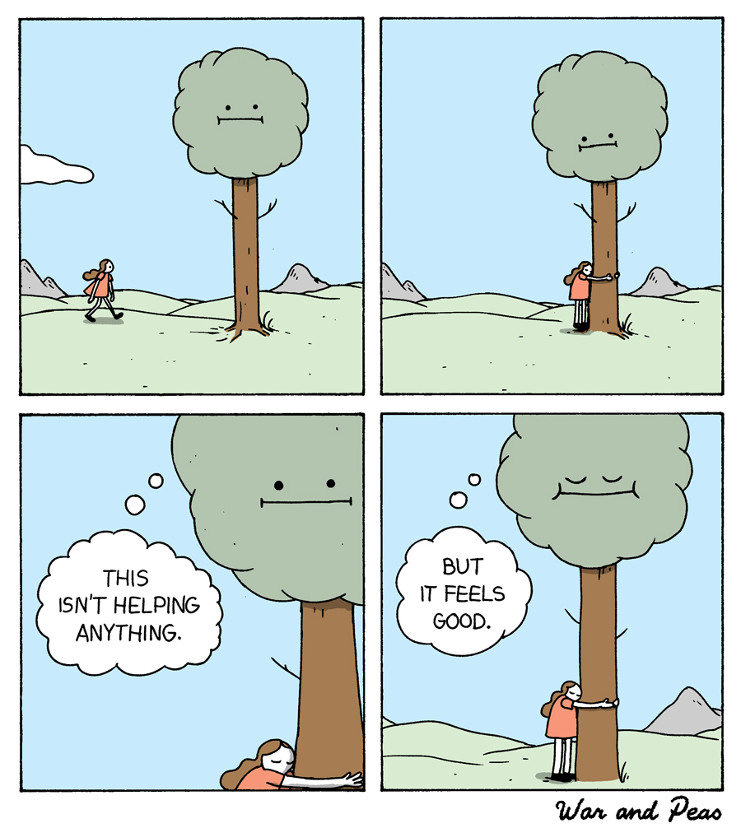
Should trees have standing?
According to Christopher Stone, rights are always a matter of judgement and debate, which is both a strength and weakness
For instance (says Stone) holding the environment as an object for our use might be equated to slavery
More generally, current owner-object relations between humans and the environment are alienating, immoral, and inconsistent, relative to democratic norms
Tools for the extension of rights
Environmental units could be given “legal standing”
Environmental torts would be decided on the basis of environmental harms rather than humans’ rights violations
These torts would be resolved by compensating the environment rather than human property owners

Slide 9
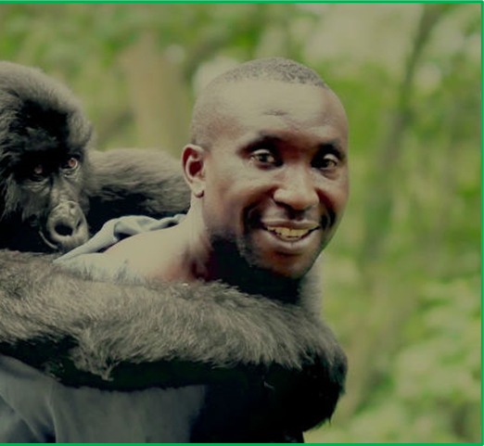
Do animal rights pass the deontological test?
There are four reasons to doubt that Stone is really concerned with rights as such
The premise: We discover rights—we don’t extend them
The subject: We collectively (self-)legislate moral duties—we don’t impose them on ourselves
The means: We show respect for rights by treating their bearers as ends—not by making them “whole again”
The ends: We realise our moral selves by constructing a categorical “kingdom of ends”—not by embracing the hypothetical imperative of treating nature with love and compassion
Notes:
To whom do we owe respect: the park warden, or the gorilla?
Just a word of explanation: in the face-to-face presentation of this lecture, I talk on this slide about Schmidtz’s and Steinbock’s arguments, and I use the example of the documentary film Virunga (which follows this warden, André Bauma, in his efforts to protect mountain gorillas in the DRC. It’s heart-breaking stuff). The question I ask (in that version of the lecture) is whether we can tease out the different forms of value (or “degrees of respect”) that we ascribe to Bauma himself, the gorillas he is trying to help, and his efforts to help them. However, as I have a bit more space to interrogate the logic in the online lecture (but not infinite space to think about tangents), I have taken that discussion out. The picture is great, though, so I’m keeping it.

Slide 10
General objections to extending rights
Species egalitarianism is too demanding
Species egalitarianism suggests that we can focus our efforts on ecosystem sustainability, but by definition ecosystems are always unstable and, in the long-run, unsustainable
Moreover, species egalitarianism puts us in an impossible position when species come into conflict (e.g., the elephant management dilemma)
We cannot stipulate moral duties in the environment without a moral hierarchy
Consider one of Schmidtz’s difficult choices: should we experiment on mice or chimpanzees (or not at all)?
Schmidtz’s intuition is that while both the mouse and the chimpanzee have important moral attributes, the chimpanzee has the same teleological importance as the mouse, so if we seek to save the former it must be for other (non-teleological) reasons
Nature is not always worth preserving
Consider Wilfred Beckerman’s worry: should we seek to preserve the world as it is, or improve it?
Even if we decide to protect the world as it currently stands (or some property of it), we will still have to make trade-offs between, say, individual animals, whole species, and ecosystems

Slide 11

4. Summary
Deontology represents one of the two main approaches to environmental ethics
Deontology is the study of our duties to one another as reasoning human beings
The alternative view (which we’ll examine next week) is consequentialism, which counts the moral value of action in terms of the way it affects our welfare
The appeal of deontology is that it directly addresses the question of what reason entails (i.e., what we owe one another as morally equal humans)
Deontology is concerned with universal truth: what do we know just because we can reason? What makes us free (autonomous), and what is the extent of the unfree (heteronomy)?
Deontology therefore does not begin from conclusions (a big plus): if we cannot extend a reason universally, it does not count
However it is questionable how useful deontology is in the realm of environmental protection
Despite the appeal of “animal rights” narrative, it is difficult to avoid the implications of our needing to rely on human reason to identify our duties to nature: if reason must (always) be agreed between people, how can it supply duties that concern anything other than those people?

